Slide 1
MACHINE TRANSLATION
English fgUnh
Eklavya Mehta
Lakshmi Madhuri Yalamanchi
Raj Vamshi Yepuru
Snehaa Vijayanand Potdar

Slide 2

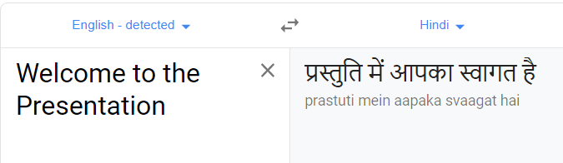
THE PROBLEM
Language Translation is a task with the potential for global impact.
In order to overcome the language barrier in the globalized society, we chose to create a language translation model.

Slide 3
Encoder-Decoder Models
Encoder-decoder models are the simplest version of Neural Machine Translation(NMT).
The idea is relatively simple: we read in the words of a target sentence one-by-one using a recurrent neural network, then predict the words in the target sentence.

Slide 4
DATA
This dataset is primarily intended for translation tasks from English to Indian Language Hindi.
Source : Data set is downloaded from
http://lotus.kuee.kyoto-u.ac.jp/WAT/indic-multilingual/index.html
Size : The data set has 84557 lines which consists of 17906 unique English words and 21973 unique Hindi words.
Format : The examples come in source-target sentence pairs, in the following format
Source sentence : You was lucky there, weren't you?
Target Translation : तुम्‍हारी किस्‍मत अच्‍छी थी, नहीं थी क्‍या?

Slide 5
DATA ANALYSIS & APPROACH
English and Hindi Text preprocessing
~10000 English text lines omitted from target file and corresponding Input file
Network structure definition for the encoder and the decoder
Network training
Model deployment and evaluation

Slide 6
MODELS / METHODS
Model 1: Character level Sequence – Sequence Model (LSTM)
Model 2: Sequential LSTM model at Word level
Model 3: Sequential LSTM with Adam/RMSPROP/SGD optimizers.
Model 4 :Sequential LSTM model incorporating Self-attention mechanism

Slide 7
MODELS / METHODS
01
02
CHAR 2 CHAR
Character level Sequence – Sequence Model (LSTM)
WORD 2 WORD
Sequential LSTM model at Word level
W2W
HYPER PARAMETER
Adam/RMSPROP/SGD
W2W
ATTENTION
GRU model incorporating Self-attention mechanism
03
04

Slide 8
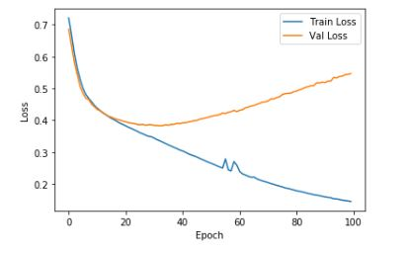
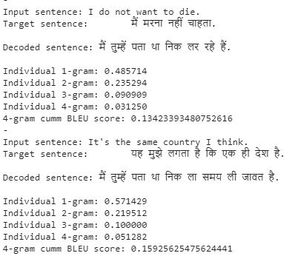
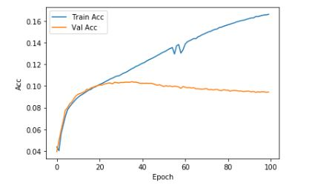
MODEL 1: CHAR 2 CHAR
Char2Char model was attempted at:
1. 256 latent dimensions
Batch size 64
Adam optimizer
100 epochs
4000 samples
2. 512 latent dimensions
Batch size 64
RMSProp optimizer
130 epochs
7000 samples
Best loss model checkpoint callback used is:

Slide 9
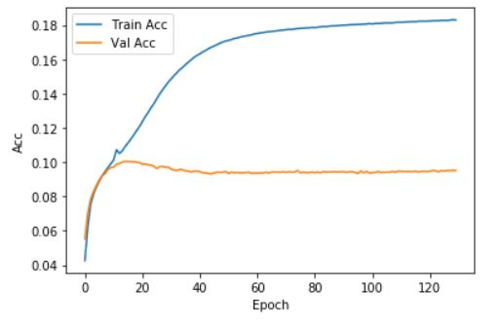
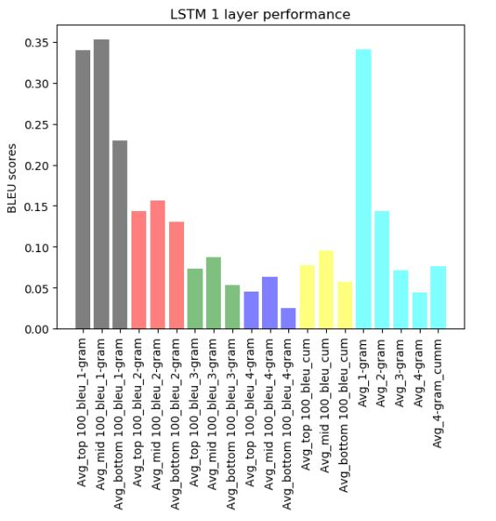
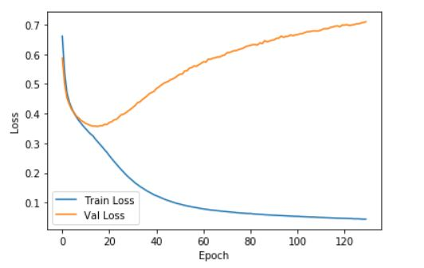
MODEL 1 - RESULTS
Char2Char results:
LOSS:
Train: 0.0445
Validation: 0.7092
ACCURACY:
Train: 0.1830
Validation: 0.0952
BLEU score:
Max: 0.35
Min: 0.025
Avg: 0.169

Slide 10
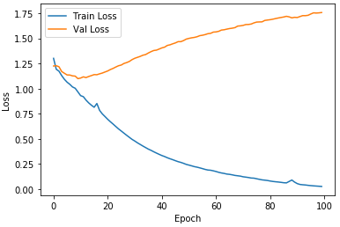
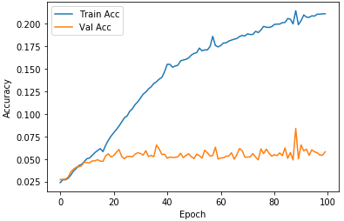
MODEL 2: WORD 2 WORD
1.
1. 512 latent dimensions
Batch size 64
ADAM optimizer
100 epochs
7000 samples
2-layer stacked LSTM encoder-decoder model
Best loss model checkpoint callback used

Slide 11
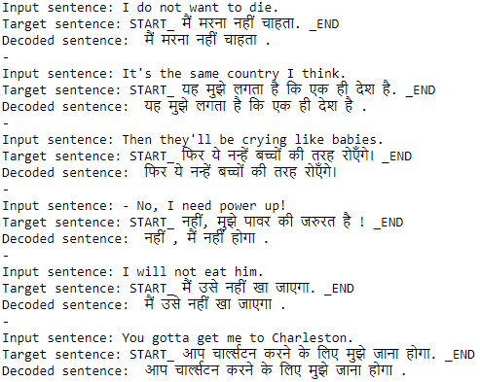
MODEL 2 : RESULTS
W2W model gave satisfactory results
LOSS:
Train: 0.0562
Validation: 1.8024
ACCURACY:
Train: 0.1972
Validation: 0.0483
BLEU 4- gram cumm score:
Max: 0.983
Min: 0.023
Avg: 0.651

Slide 12
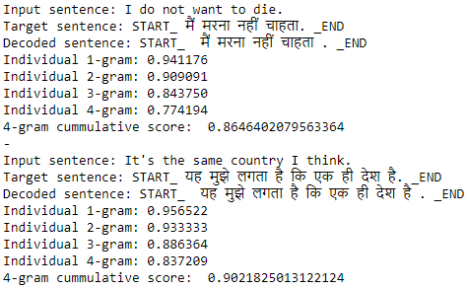
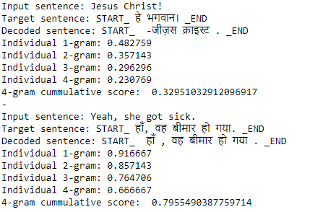
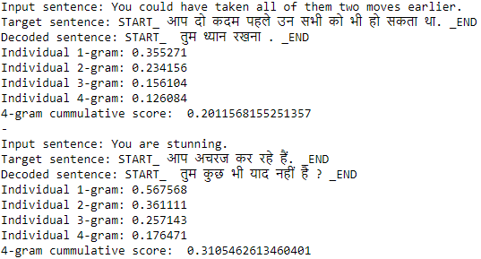
MODEL 2 - RESULTS
Top 100 sample
BLEU scores in depth:
Assessed for 300 samples:
Top 100 samples
Middle 100 samples
Bottom 100 samples
Individual n-gram: 1 to 4
Cumulative 4-gram
BLEU score summary:
Top 200 sample
Top 300 sample

Slide 13
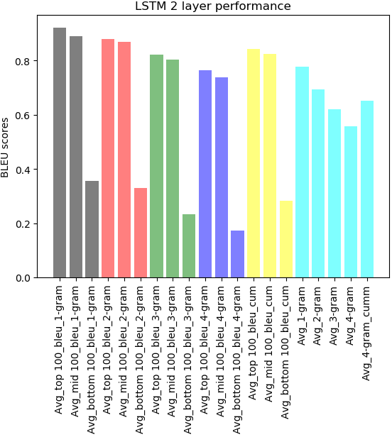
MODEL 2 - RESULTS
BLEU scores in depth:
Assessed for 300 samples:
Top 100 samples
Middle 100 samples
Bottom 100 samples
Individual n-gram: 1 to 4
Cumulative 4-gram
BLEU score summary: Top samples train very well
N-gram | Top 100 | Mid 100 | Bottom 100 | All 300
1 | 0.92 | 0.89 | 0.36 | 0.78
2 | 0.88 | 0.87 | 0.33 | 0.69
3 | 0.82 | 0.80 | 0.23 | 0.62
4 | 0.77 | 0.74 | 0.17 | 0.56
4- gram cumulative | 0.84 | 0.83 | 0.28 | 0.65

Slide 14
MODEL 3 - Models with Hyper parameter Optimization
Hyperparameters refer to the parameters that are set before the start of training.
Optimizers
Learning rate
Type of attention
Attention Architecture
Inference mode
Notes:
The tune-ability of an algorithm, hyperparameter, or interacting hyperparameters is a measure of how much performance can be gained by tuning it. For an LSTM, the learning rate followed by the network size are its most crucial hyperparameters.

Slide 15
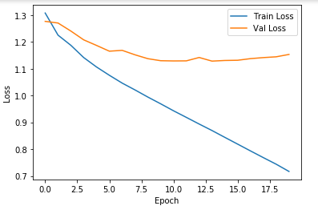
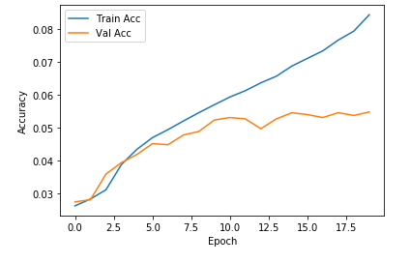
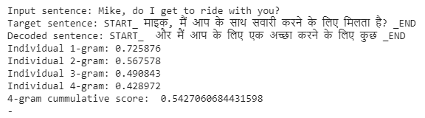
MODEL 3 : Using RMS Prop
RMSProp optimizer
Latent Dimension : 512
Epoch : 30
Sample : 5000
Batch Size : 64
Max Cumulative Blue Score : 0.54
Avg Cumulative Blue Score : 0.29

Slide 16
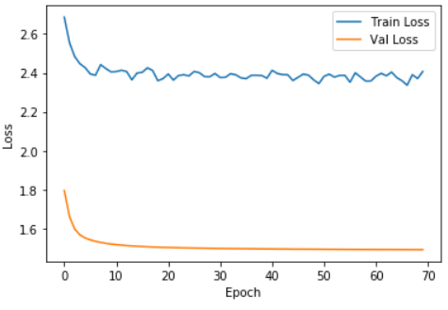
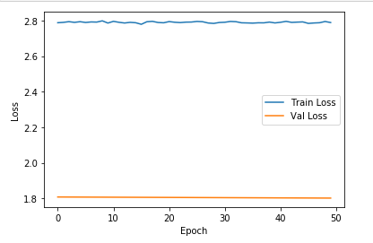
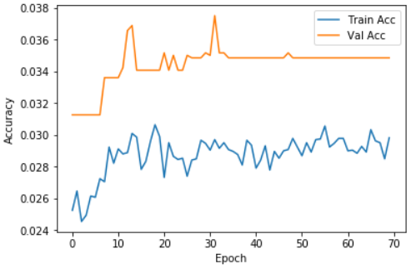
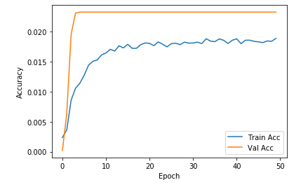
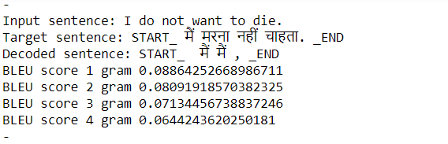
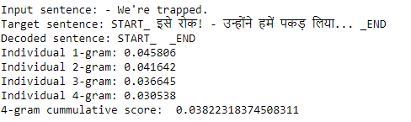
MODEL 3 : Using SGD
SGD optimizer with Drop out (round 1)
Latent Dimension : 512
Epoch : 50
Sample : 7000
Batch Size : 128
Max Cumulative Blue Score : 0.05
SGD optimizer with Drop out (round 2)
Latent Dimension : 256
Epoch : 70
Sample : 1000
Batch Size : 64
Max Cumulative Bleu Score : 0.512
Avg Cumulative Bleu Score : 0.244

Slide 17
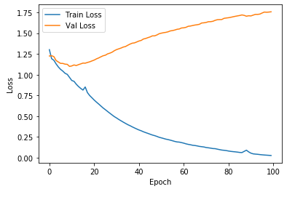
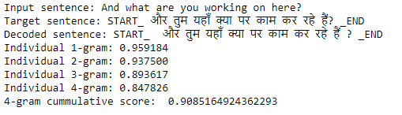
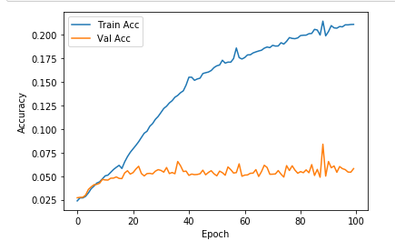
MODEL 3 : Using ADAM
ADAM optimizer
Latent Dimension : 512
Epoch : 100
Sample : 7000
Batch Size : 64
Max Cumulative Blue Score : 0.9

Slide 18
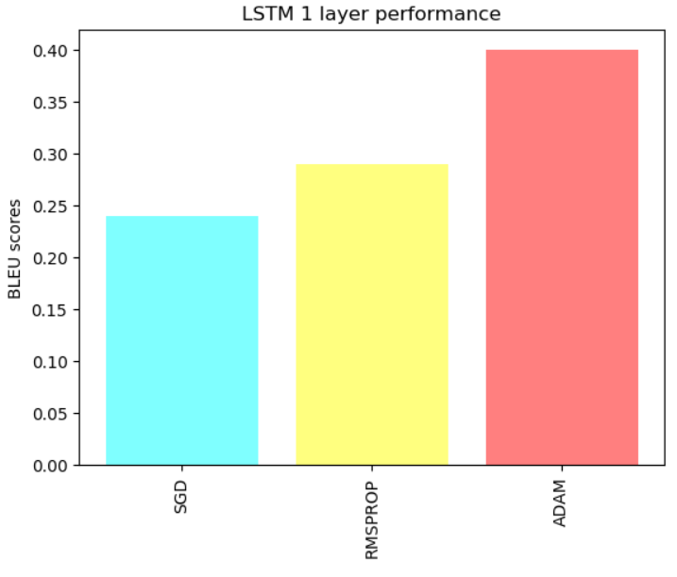
MODEL 3 : Comparison over Optimizers
Best Model :
Based on the Bleu scores, the best
model for this data set is model which
used ADAM optimizers.

Slide 19
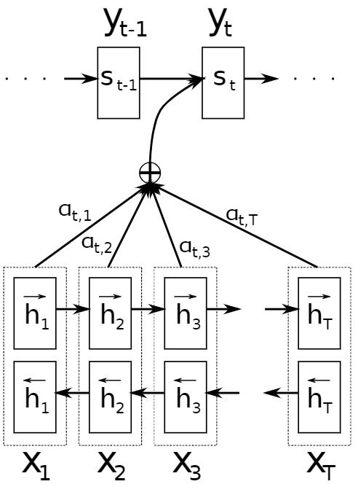
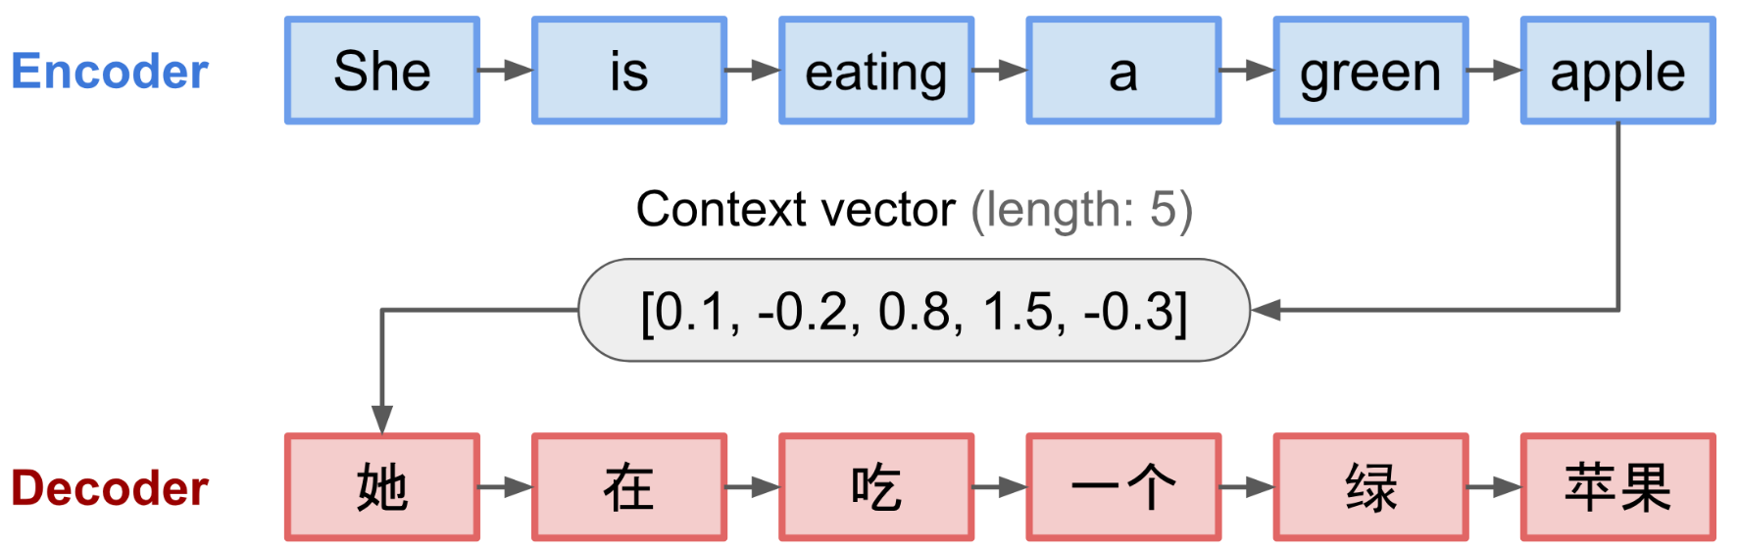
MODEL 4 – Attention
Clark is a good boy
Model uses GRU layers (instead of LSTM layers) along with
attention model
Humans are able to easily understand mappings between
different parts of an input sequence and a translated sequence
Attention mechanism is developed to “learn” these mappings
through Gradient Descent and Back-propagation
Using a fixed-length context vector in conventional model leads to incapability of the system to remember longer sequences 🡪 Attention Model tries to fix this by utilizing intermediate encoder states to construct the context vectors
Model gives good performance but is time consuming!
क्लार्क एक अच्छा लड़का है
Decoder RNN
Attention Layer
Encoder RNN
Conventional Encoder – Decoder Model
Encoder – Decoder Model with “Attention”

Slide 20
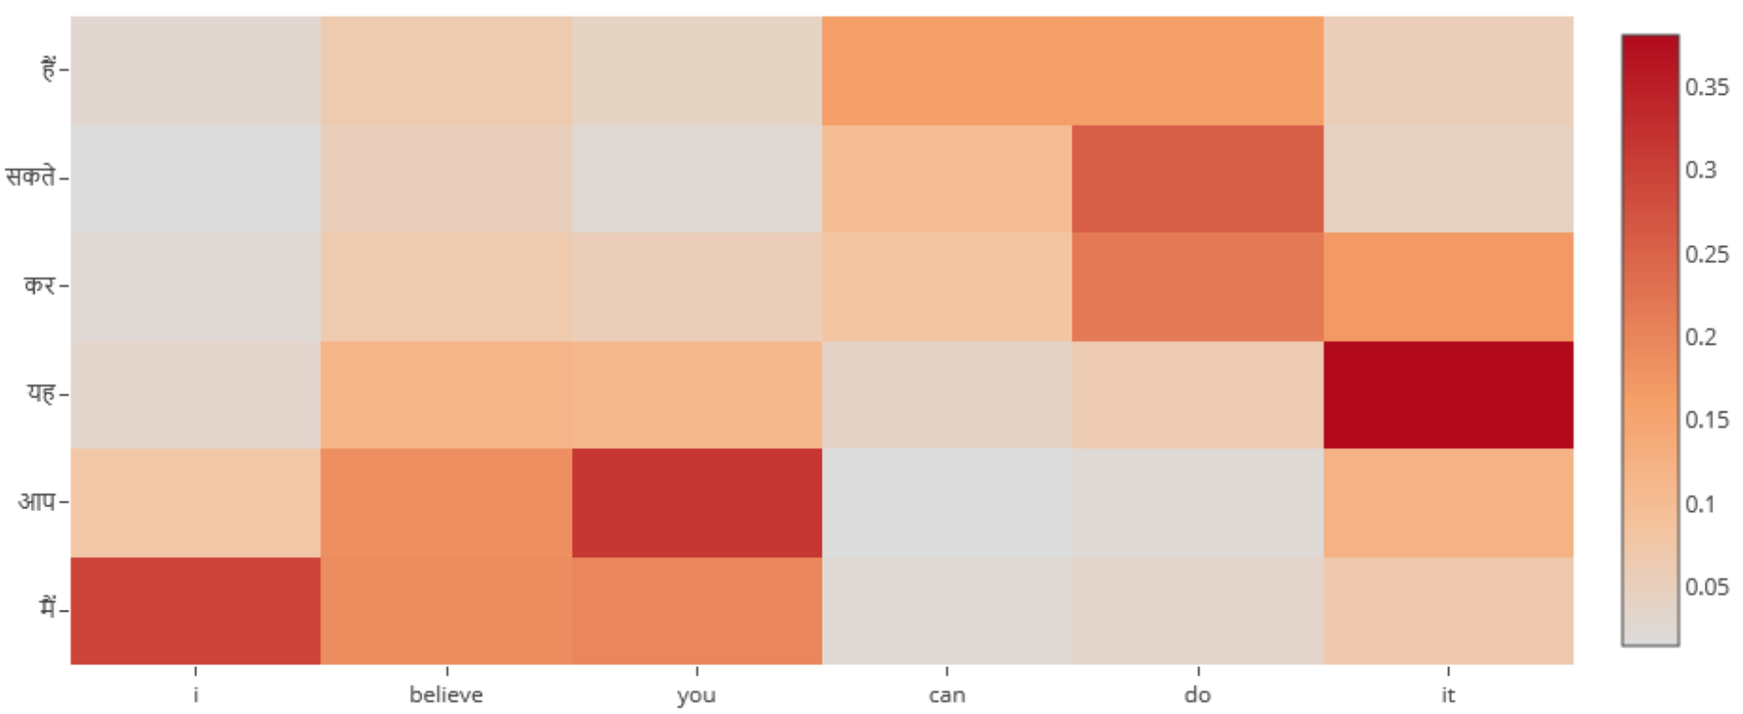
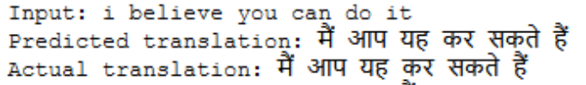
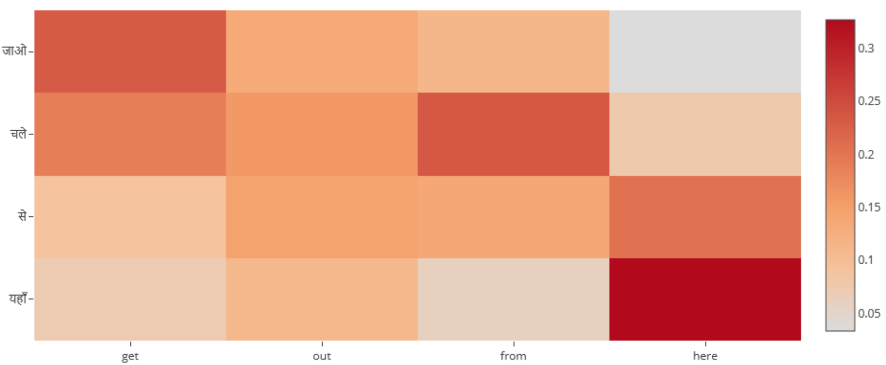
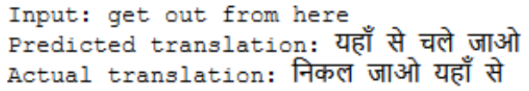
RESULTS - Attention
Model Details:
Epochs: 12
Optimizer: Adam
Samples: 78475 (80:20 split)
Results:
BLEU Score (Cumulative): 0.20
BLEU 1 Score: 0.42
BLEU 2 Score: 0.246
BLEU 3 Score: 0.158
BLEU 4 Score: 0.099
Understanding Attention weights Heatmap:
Decoder is paying “attention” to
“i” while predicting “मैं”
Decoder is paying “attention” to
“you” while predicting “आप”
Decoder is paying “attention” to
“it” while predicting “यह”
Decoder is paying “attention” to
“here” while predicting “यहाँ”

Slide 21
CONCLUSION
We concluded that in order to speed up the training and enhance the performance in terms of BLEU, one could apply Adam optimizer on a larger sample.
Run the Attention model with more epochs to improve the BLEU scores
Use “Transformer Model” which uses only Attention and gets rid of all the Convolutional and Recurrent Layers, thus making it highly parallelizable and compute efficient
Model | Best obtained Average BLEU Scores
1 | 0.17
2 | 0.65
3 | 0.40
4 | 0.20

Slide 22
FUTURE WORK
Further work can be put into exploring other algorithms for finding the good learning rate.
In addition, more research can be put into finding optimal neural architecture for NMT models.
Pre-trained word vectors could be used in the model.
A recursive formulation of the model could be used where the next word in the output sequence could be conditional on the input sequence and the output sequence generated so far

Slide 23
REFERENCES
https://arxiv.org/abs/1409.3215
https://towardsdatascience.com/understanding-encoder-decoder-sequence-to-sequence-model-679e04af4346
https://github.com/tensorflow/nmt
https://arxiv.org/pdf/1409.0473.pdf

Slide 24
QUESTIONS ?
THANK YOU

